Slide 1
UNIT V
Dividend Theory

Slide 2
Outcome
Analyze the concept of Gordon’s model of dividend relevance and the bird in the hand argument.

Slide 3
Dividend Relevance: Gordon’s Model
Maryon Gordon develops one very popular model explicitly relating the market value of the firm to dividend policy. Gordon’s model is based on the following assumptions:
All-equity firm
No external financing
Constant return
Constant cost of capital

Slide 4
Contd….
Perpetual earning
No taxes
Constant retention
Cost of capital greater than growth rate

Slide 5
MCQ
Which of the following assumption of Gordon’s valuation model is correct ?
All financing is done through retained earnings
Cost of capital is equal to growth rate
Cost of capital remains constant
None of the above

Slide 6
Answer
C. Cost of capital remains constant

Slide 7
Contd….
According to Gordon’s dividend-capitalization model, the market value of a share is equal to the present value of an infinite stream of dividends received by the shareholders.
However, the dividend per share is expected to grow when earnings are retained. The dividend per share is equal to the payout ratio, (1 – b) times earnings per share, EPS; that is,
DIV = (1 – b) EPS
where b is the fraction of retained earnings.
It is assumed that the retained earnings are reinvested within the all-equity firm at the firm’s internal rate of return, r.

Slide 8
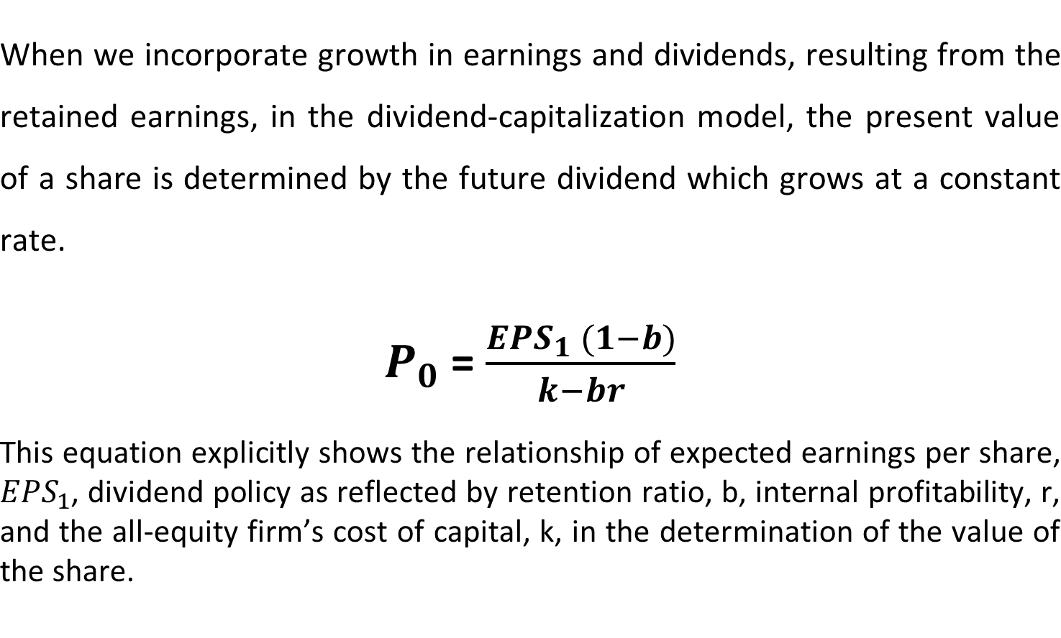
Contd…..

Slide 9
MCQ
Gordon's Model of dividend relevance is same as __________________.
No growth model of equity valuation
Constant growth model of equity valuation
Inverse price earning ratio
Price earning ratio

Slide 10
Answer
B. Constant growth model of equity valuation

Slide 11
Application of
Gordon’s Dividend Model
The implications of dividend policy, according to Gordon’s model, are shown respectively for
the growth firm ( r > K)
the normal firm ( r = K)
the declining firm ( r < K)

Slide 12
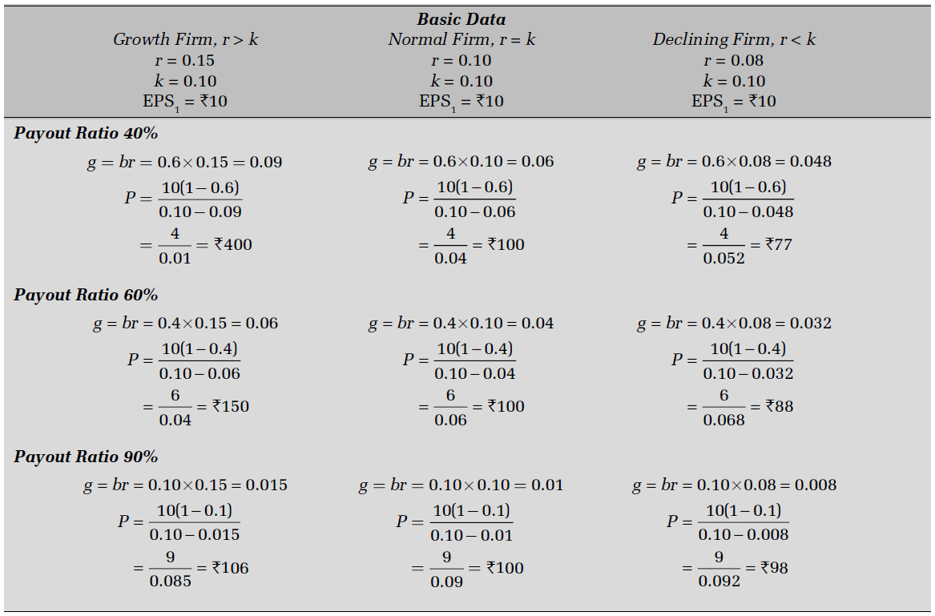

Slide 13
Contd…..
It is revealed that under Gordon’s model:
The market value of the share, P0, increases with the retention ratio, b, for firms with growth opportunities, i.e., when r > k.
The market value of the share, P0, increases with the payout ratio, (1 – b), for declining firms with r < k.
The market value of the share is not affected by dividend policy when r = k.

Slide 14
MCQ
In case of Gordon's Model, the MP for zero payout is zero. It means that ________________.
Shares are not traded
Shares available free of cost
Investors are not ready to offer any price
None of the above

Slide 15
Answer
C. Investors are not ready to offer any price

Slide 16
Dividend & Uncertainty:
The Bird-in-The-Hand Argument
According to Gordon’s model, dividend policy is relevant but it may become irrelevant where r = k, when all other assumptions are held valid. But when the simplifying assumptions are modified to conform more closely to reality, Gordon concludes that dividend policy does affect the value of a share even when r = k. This view is based on the assumption that under conditions of uncertainty,
Investors tend to discount distant dividends (capital gains) at a higher rate than they discount near dividends.

Slide 17
Contd….
Investors, behaving rationally, are risk averse and, therefore, have a preference for near dividends to future dividends.
The logic underlying the dividend effect on the share value can be described as the bird-in-the-hand argument.

Slide 18
Contd…..
Myron Gordon has expressed the bird-in-the-hand argument more convincingly and in formal terms.
According to him, uncertainty increases with futurity; i.e., the further one looks into the future, the more uncertain dividends become. Accordingly, when dividend policy is considered in the context of uncertainty, the appropriate discount rate, k, cannot be assumed to be constant. In fact, it increases with uncertainty; investors prefer to avoid uncertainty and would be willing to pay higher price for the share that pays the greater current dividend, all other things held constant.

Slide 19
Contd….
In other words, the appropriate discount rate would increase with the retention rate Thus, distant dividends would be discounted at a higher rate than near dividends. To emphasize, he reached this conclusion through two assumptions regarding investors’ behaviour:
investors are risk averters.
they consider distant dividends as less certain than near dividends.

Slide 20
MCQ
Gordon’s “bird-in-the-hand” argument suggests that
dividends are irrelevant.
firms should have a 100 percent payout policy.
shareholders are generally risk averse and attach less risk to current dividends.
the market value of the firm is unaffected by dividend policy.

Slide 21
Answer
C. shareholders are generally risk averse and attach less risk to current dividends.

